Slide 1
Application of Ensemble Clustering and Survival Tree Analysis for Identifying Prognostic Clinicogenomic Features in Patients with Colorectal Cancer from the 100,000 Genomes Project

Slide 2

Speaker’s Background
2015-2019 Statistics (Bachelor) – University of Glasgow & 中南财经政法大学
2019-2020 Health Data Science (Master) - Institute of Health Informatics - University College London
2018 Customer Success Specialist (Intern) - Service & Support - Illumina
2021-now Advanced Application –GE Healthcare
Medical Statistics, Statistical Genetics, Machine Learning, Deep Learning

Slide 3
Application of Ensemble Clustering and Survival Tree Analysis for Identifying Prognostic Clinicogenomic Features in Patients with Colorectal Cancer from the 100,000 Genomes Project
Abstract
Derived data including demographic details, histology differentiation, grades, treatments, genetic factors from routinely collected electronic health records (EHRs) linked to whole-genome sequences.
Obtain a set of clusters, which combined the results of several clustering algorithms by a consensus function.
Survival analysis for the whole colorectal cancer patients to exam the relationship of prognosis factors and outcomes
Explore the feature profiles for the clusters obtained by survival analysis (including K-M estimator, Cox proportional-hazards model, and the tree-structured survival models).
Create a prognosis system with the result of clustering and tree-structured survival models

Slide 4
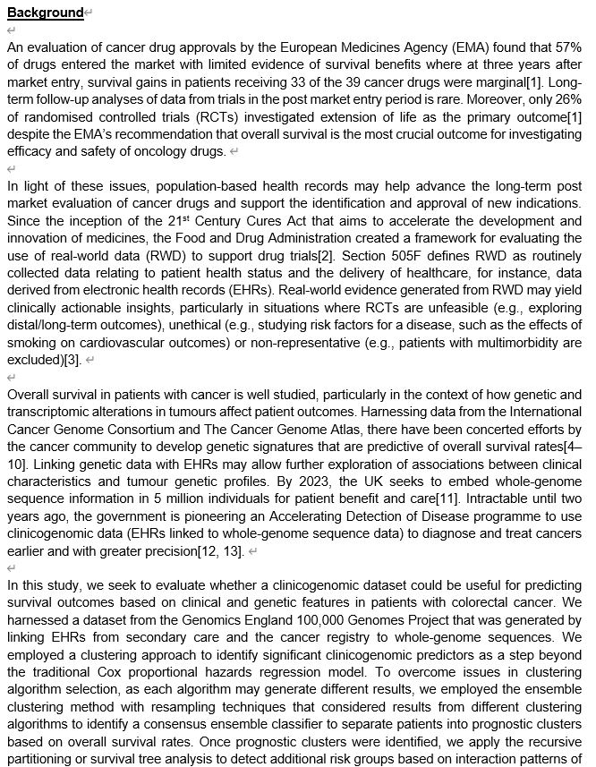
Application of Ensemble Clustering and Survival Tree Analysis for Identifying Prognostic Clinicogenomic Features in Patients with Colorectal Cancer from the 100,000 Genomes Project
Background

Slide 5




Slide 6
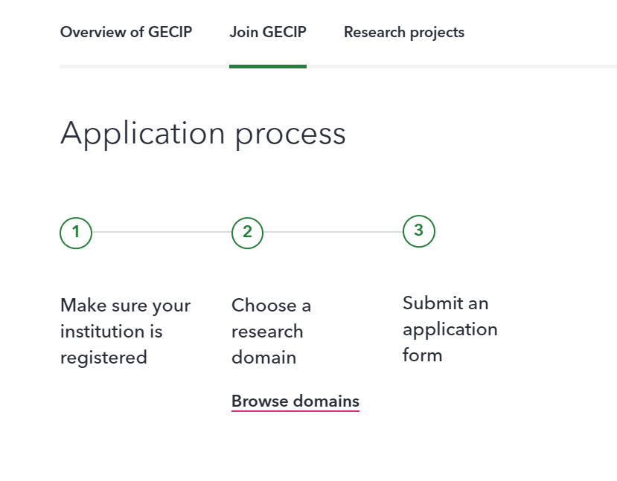
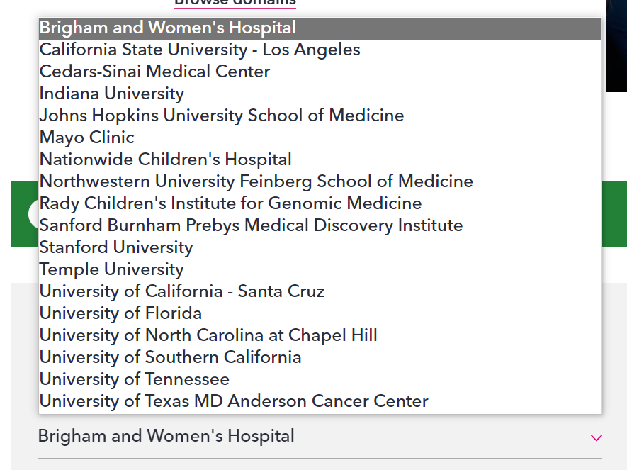

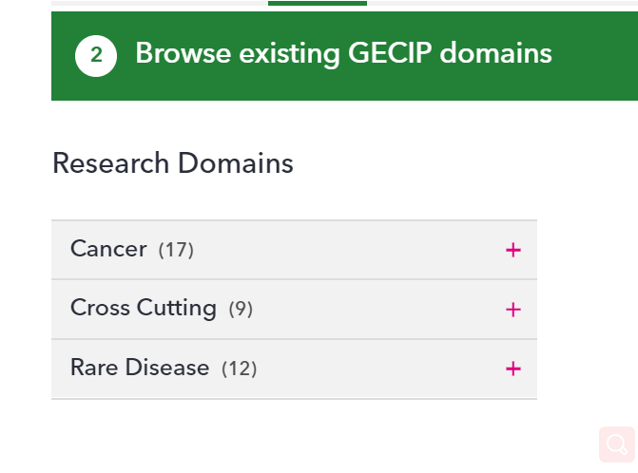


Slide 7


https://cnfl.extge.co.uk/display/GERE/Genomics+England+Research+Environment

Slide 8
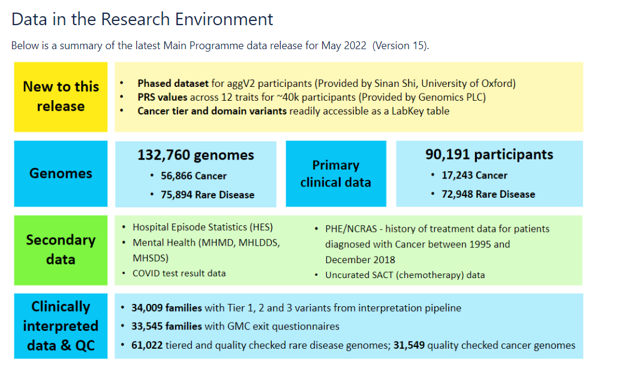
每季度更新

Slide 9
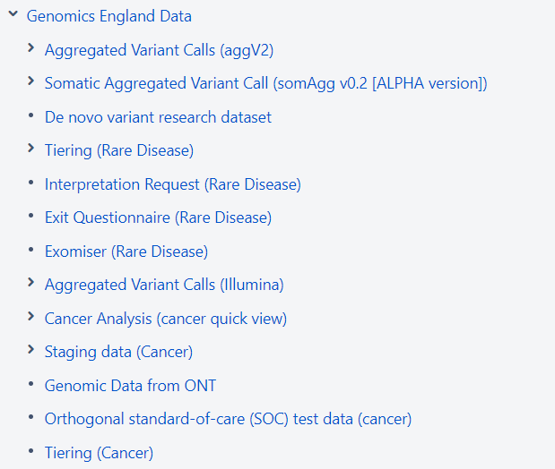
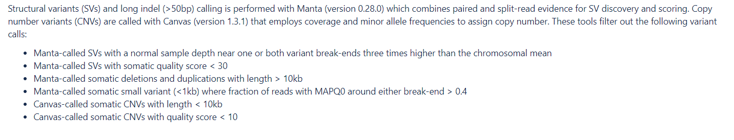
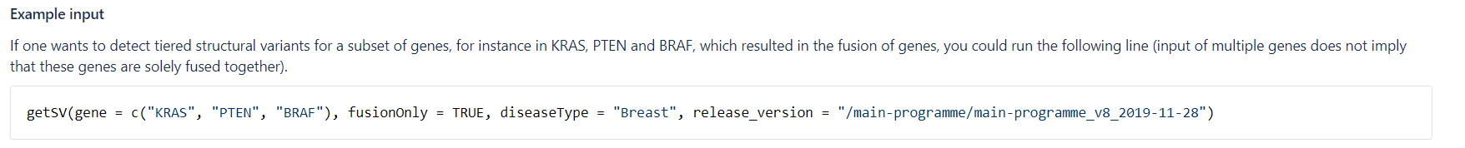
Data Extraction

Slide 10
Features
Demographic variables include:
Age (at diagnosis)
Sex: binary variable: 0 for male, 1 for female
Hospital Episode Statistics (HES) data include:
Diagnosis date
Stage: AJCC staging system combining the TMN scoring, marked from 0 to 4.
Grades of differentiation:
GX: The degree of differentiation cannot be assessed;
G1: Well differentiated;
G2: Moderately differentiated;
G3: Poorly differentiated;
G4: Undifferentiated / anaplastic
Tumour type: primary, metastases, and recurrence of tumour

Slide 11
Features
National Cancer Registration and Analysis Service (NCRAS) data include:
Treatment: four attributes (surgery, chemotherapy, immunotherapy, and radiotherapy). Each attribute is a binary variable. 1 means patients have a record for this kind of treatment event.
Genetic factors include:
Somatic coding variants per mb (SCV): a continuous variable, covering the total number of somatic non-synonymous SNVs per megabase in the coding region
Gene mutations: BRAF, KRAS, NRAS
Office for National Statistics (ONS) death registrations data include:
Cause of death: coded by ICD-10
Event date: death date / end date of observation phase

Slide 12
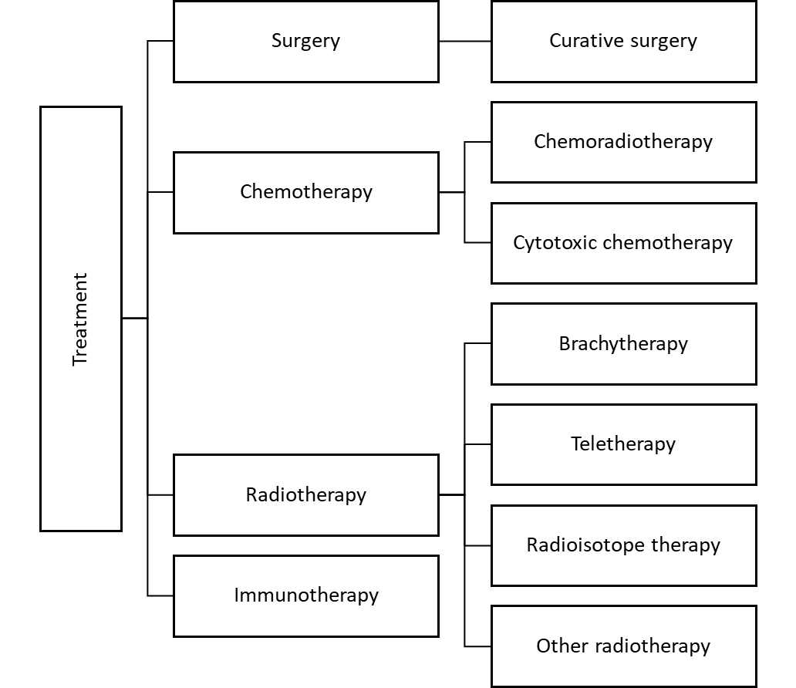
Treatment events related to cancer curatives

Slide 13
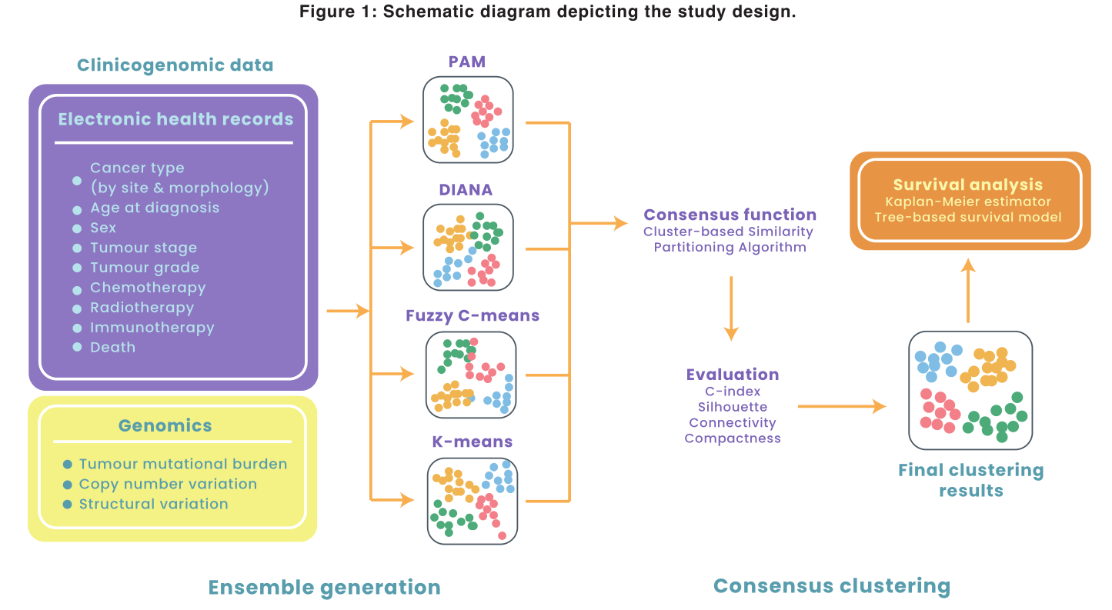

Slide 14

Clustering Algorithms
K-means clustering: this is a method that assigns objects into k clusters i.e. the cluster with the minimum mean. This method is efficient, especially for large datasets.
Partitioning Around Medoids (PAM) clustering: this is a clustering technique similar to K-means clustering, used to minimise the average dissimilarity of objects to their closest selected object by finding ‘medoids’ that are positioned in the centre of the clusters.
Hierarchical Clustering: this includes the bottom-up method known as agglomerative clustering (AGNES) and the bottom-down method known as divisive analysis of hierarchical clustering (DIANA). Divisive clustering algorithms start with one cluster that includes all the objects. At each step of iteration, the cluster is split into the two most heterogeneous clusters. Divisive clustering algorithms perform better than agglomerative clustering for large sample sizes. A divisive clustering algorithm is thus selected for this study.
Fuzzy c-means: this is clustering technique in which data belong to one or more cluster, possessing different degrees for each different cluster by a generalized least-squares objective function.

Slide 15
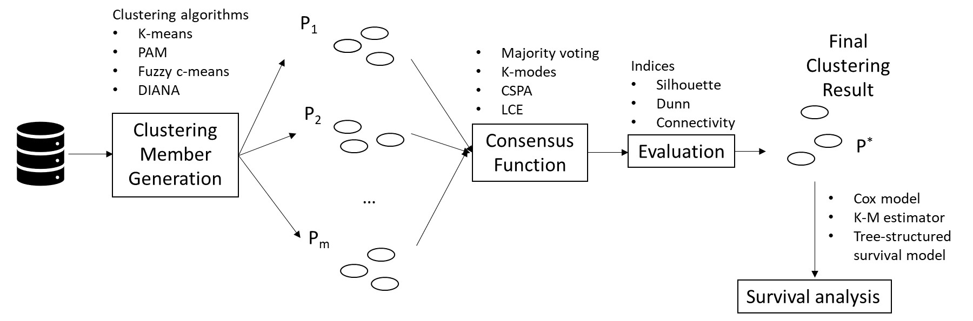
Consensus Function
Majority voting: partition members are merged via a voting process
K-modes: this process treats the partition members as categories and applies a k-modes algorithm
CSPA: this establishes a measure of pairwise similarity, then uses this induced similarity measure to re-cluster the objects and to obtain a combined cluster.
LCE: this process measures the similarity between clusters that are estimated from a link network model of the ensemble.

Slide 16
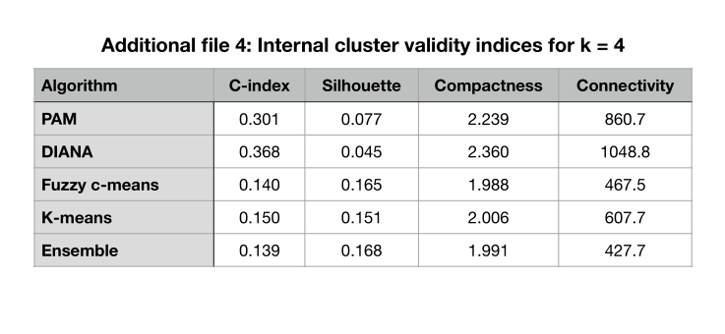
Results
Descriptive Statistics for the Prognostic Clusters
 | Cluster 1 (N= 213) | Cluster 2 (N= 510) | Cluster 3 (N= 420) | Cluster 4 (N= 187)
SCV (SD) | 66.7(±33.5) | 5.2(±6.5) | 7.5(±6.9) | 14.6(±15.0)
Sex: Male | 86(40.4%) | 322(63.1%) | 267(63.6%) | 123(65.8%)
Age group: <30 | 3 (1.4%) | 0 (0.0%) | 1 (0.2%) | 1 (0.5%)
Age group: 31-50 | 14 (6.6%) | 18 (3.5%) | 56 (13.3%) | 19 (10.2%)
Age group: 51-70 | 77(36.2%) | 245(48.0%) | 209(50.0%) | 99(52.9%)
Age group: >70 | 119(55.9%) | 247(48.4%) | 154(36.7%) | 68(36.4%)
Stage 1 | 81 (38.0%) | 118 (23.1%) | 0 (0.0%) | 0 (0.0%)
Stage 2 | 132(62.0%) | 320(62.7%) | 12(2.9%) | 3(1.6%)
Stage 3 | 0(0.0%) | 64(30.0%) | 346(82.4%) | 124(66.3%)
Stage 4 | 0(0.0%) | 8(3.8%) | 62(14.8%) | 60(32.1%)
Chemotherapy | 66(31.0%) | 89(17.5%) | 322(76.7%) | 153(81.8%)
Radiotherapy | 9 (4.2%) | 29 (5.7%) | 47 (11.2%) | 26 (13.9%)
Immunotherapy | 1 (0.5%) | 2 (0.4%) | 6 (1.4%) | 6 (3.2%)
KRAS | 30 (14.1%) | 188 (36.9%) | 70 (16.7%) | 156(83.4%)
BRAF | 22 (10.3%) | 177 (34.7%) | 59 (14.0%) | 138(73.8%)
NRAS | 9 (4.2%) | 142 (27.8%) | 62 (14.8%) | 126(67.4%)
One-year survival rate* | 98.9% | 96.4% | 97.7% | 79.2%
Two-year survival rate* | 97.5% | 92.0% | 90.8% | 46.3%
Three-year survival rate* | 89.4% | 87.4% | 78.3% | 11.1%

Slide 17
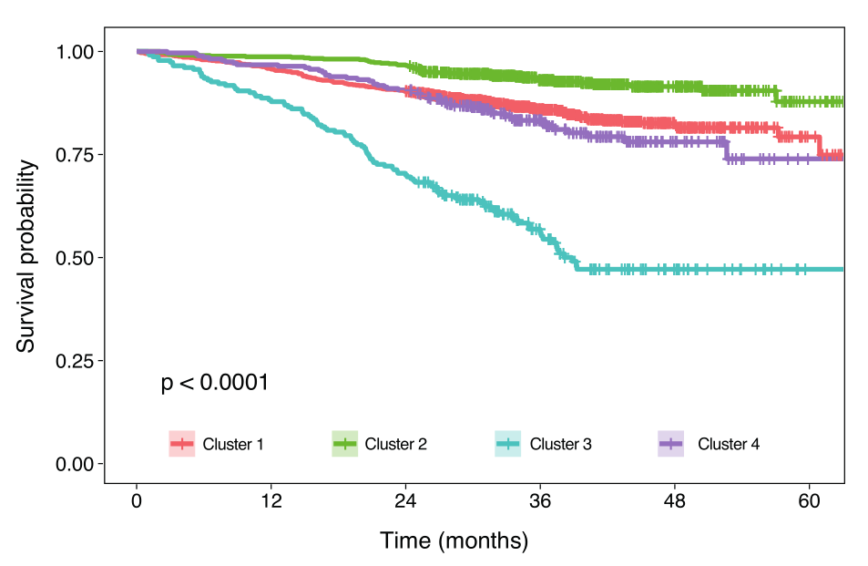
Overall survival outcomes in patients with colorectal cancer stratified using the ensemble clustering approach

Slide 18
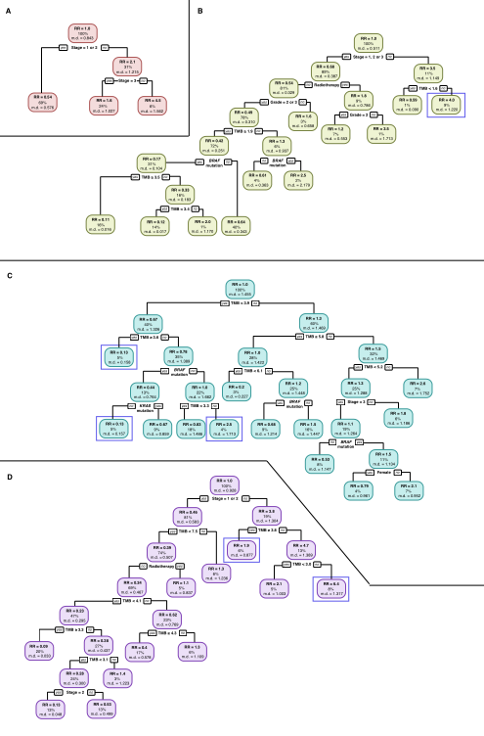
Survival Tree Analyses
Survival tree analyses for each of the four prognostic clusters. (A) cluster 1, (B) cluster 2, (C), cluster 3 and (D) cluster 4.
Proportion of patients within each
node are indicated as a percentage.
Relative risk (RR) for each node is indicated, along with the mean deviance (m.d.) value.
Nodes described in the results section
are highlighted in blue boxes

Slide 19
Conclusion
Genomics England Research Environment
Clustering Algorithms
Consensus Function
Survival Analyses

Slide 20
Thanks！

